Slide 1

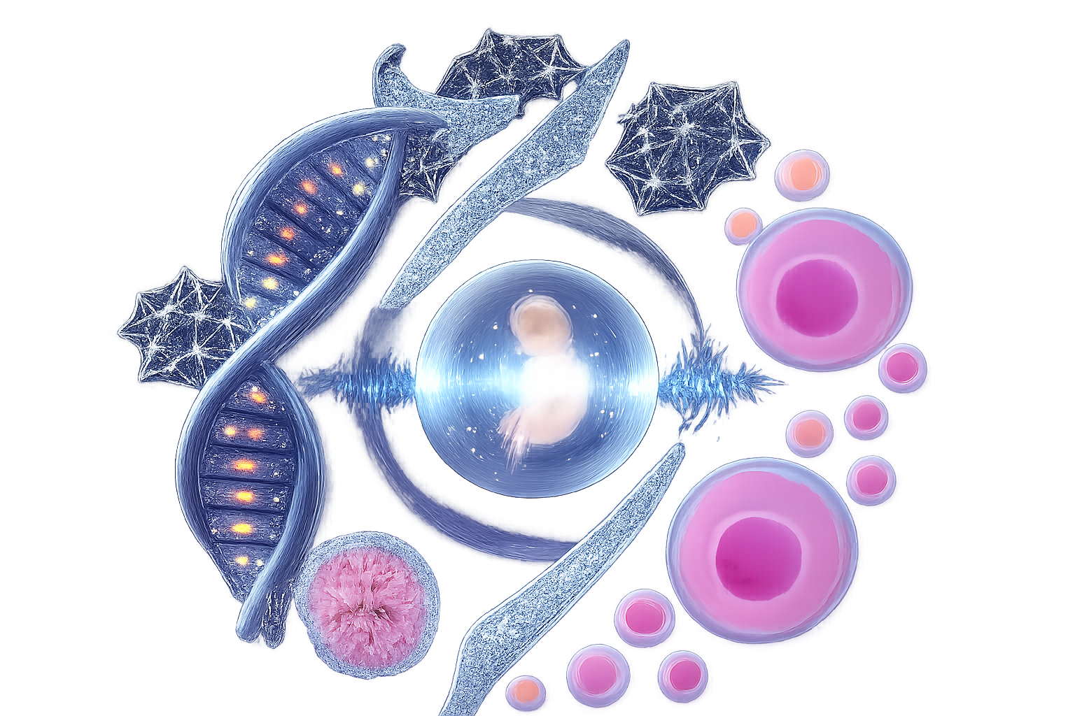

The firt student congress on research and technology of Dr. Kazemi Ashtiani
University of Medical Sciences of QOM, IRAN | 24,25 Dec 2025

Slide 2
Type:
Code:
Title
Time new roman
Font size: 30-40 point
Name and Affiliation
Time new roman
20-25 point

Slide 3
Introduction
Time new roman
Font size: 36-44
Main text: 26-32

Slide 4
Method
Time new roman
Font size: 36-44
Main text: 26-32

Slide 5
Method
Time new roman
Font size: 36-44
Main text: 26-32

Slide 6
Results
Time new roman
Font size: 36-44
Main text: 26-32

Slide 7
Discuss
Time new roman
Font size: 36-44
Main text: 26-32

Slide 8
Conclusion
Time new roman
Font size: 36-44
Main text: 26-32

Slide 9
Reference
Time new roman
Font size: 36-44
Main text: 22-24
Maximum: 10

